Slide 1

When, Where and Why to apply code to solve a problem
DYNAMICS 365

Slide 2

Mitch Milam
mitch@xrmcoaches.com
@mitchmilam
linkedin.com/in/mitchmilam
youtube.com/xRMCoaches

Slide 3
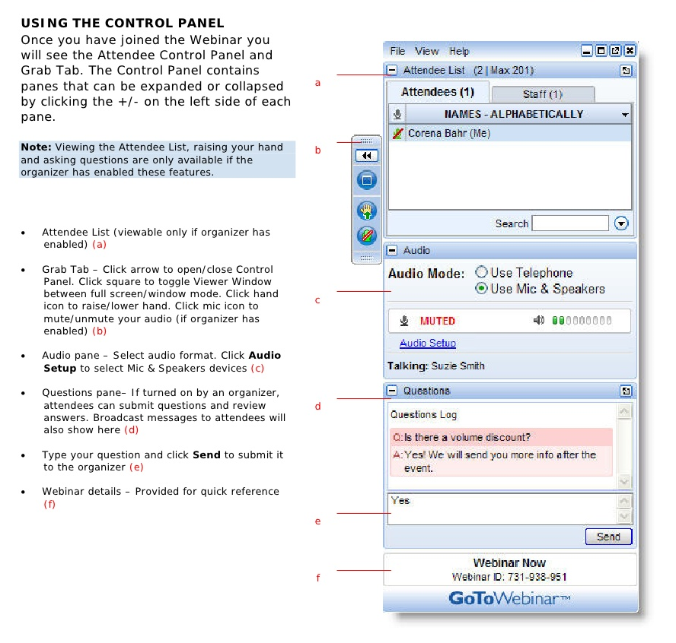
Webinar Housekeeping

Slide 4
Agenda
When
Where
Why
Technology
Tools

Slide 5

Announcements

Slide 6
Announcements
SnapShot! for Dynamics CRM and Dynamics 365
Will ship on Monday, August 7th
Version 4.5
Lots of new features
The ultimate documentation tool for Dynamics CRM and Dynamics 365

Slide 7
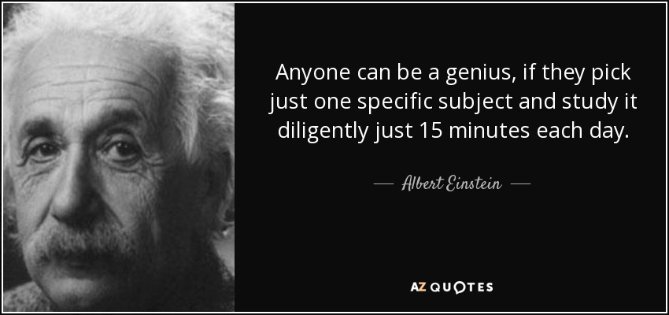

Slide 8
When

Slide 9
Immediacy
Does the user need to see something immediately?
Can the function be performed during a Save operation?
Does the user need to be involved in the conversation?

Slide 10
Modifications by Non-Developers
Do you have the staff required to create and maintain a the solution?
Will users, other than developers, need to make changes?

Slide 11
On-Demand
Does the operation need to occur every time a specific action is taken?
Will there ever been a point in time where a user needs to manually execute your code or solution?

Slide 12
Where

Slide 13
Technologies
Automation Interfaces
Business Rules
Synchronous workflows
Asynchronous workflows
Plugins
JavaScript
Microsoft Flow
PowerApps

Slide 14
Why

Slide 15
Does an out of the box feature do the job?

Slide 16
Out of the Box Features
Calculated fields
Rollup fields
Form configuration
Field-level security

Slide 17
Is the task within my skillset?

Slide 18
Skills
Which of the following do I know how to do:
Business Rules
Synchronous workflows
Asynchronous workflows
JavaScript
Microsoft Flow
Plugins

Slide 19
What do I want to be when I grow up?

Slide 20
Skills
Which of the following do I need to learn:
Business Rules
Synchronous workflows
Asynchronous workflows
JavaScript
Microsoft Flow
Plugins

Slide 21
Business Rules

Slide 22
Advantages
Easy to create
No JavaScript knowledge required
Can run at the server level
Can run on multiple devices/platforms

Slide 23
Limitations
Only run when the form loads and when field values change. They do not run when a record is saved, unless the scope for the rule is set at an entity level.
Business rules work only with fields.
When you set a field value by using a business rule, any OnChange event handlers for that field will not run.
If a business rule references a field that is not present on a form, the rule will simply not run.

Slide 24
Limitations cont.
Whole Number fields that use the formats for TimeZone, Duration, or Language will not appear in the rule editor for the conditions or actions, so they cannot be used with business rules.
For Microsoft Dynamics CRM for tablets, the definition of the business rules are downloaded and cached when CRM for tablets opens. Changes made to business rules are not applied until CRM for tablets is closed and re-opened.
When you set the value of a lookup field, the text of the primary field value that is set in the form will always match the text that is visible in the rule definition

Slide 25
Workflows

Slide 26
Tip
Let someone else do the hard work

Slide 27
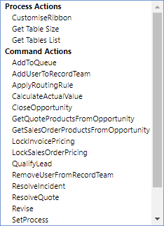
Actions

Slide 28
Custom Workflow Activities
CRM Email Workflow Utilities
CRM String Workflow Utilities
CRM Numeric Workflow Utilities
CRM DateTime Workflow Utilities
https://github.com/jlattimer
Dynamics CRM 2016 Workflow Tools
https://github.com/demianrasko/Dynamics-365-Workflow-Tools
Ultimate Workflow Toolkit
https://github.com/a33ik/UltimateWorkflowToolkit/releases/tag/v1.1.0.0

Slide 29
JavaScript

Slide 30
JavaScript
The most utilitarian technology
Can be used
On forms
From ribbon buttons
Lots of great samples in the community

Slide 31
Microsoft Flow

Slide 32
Microsoft Flow
Microsoft Flow is a product to help you set up automated workflows between your favorite apps and services to synchronize files, get notifications, collect data, and more.

Slide 33
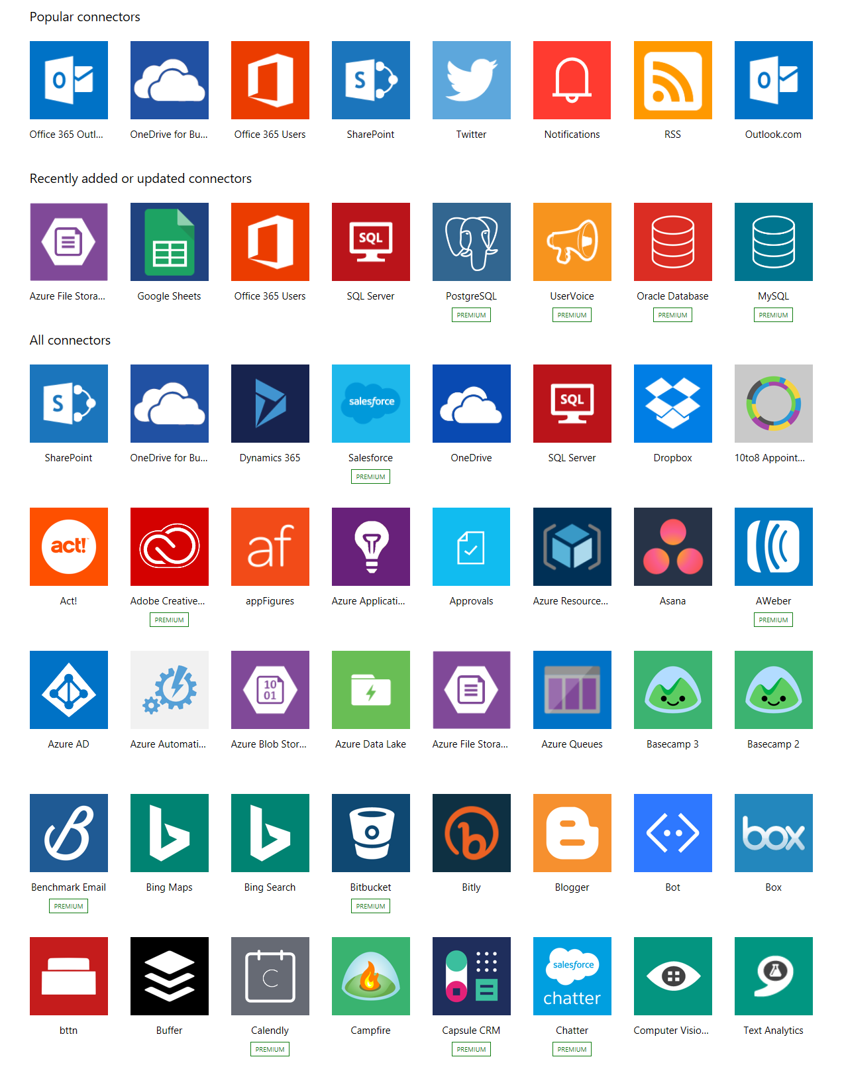
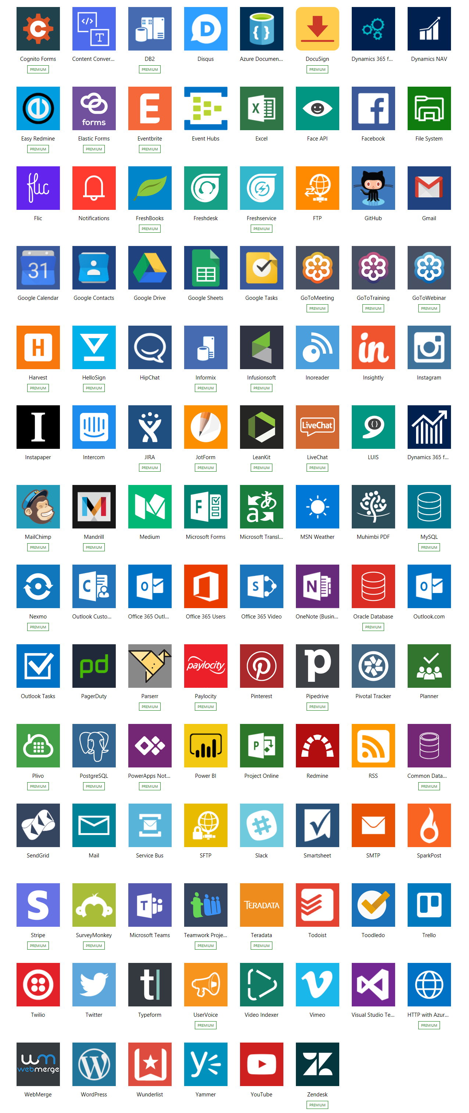
Connectors

Slide 34
PowerApps

Slide 35
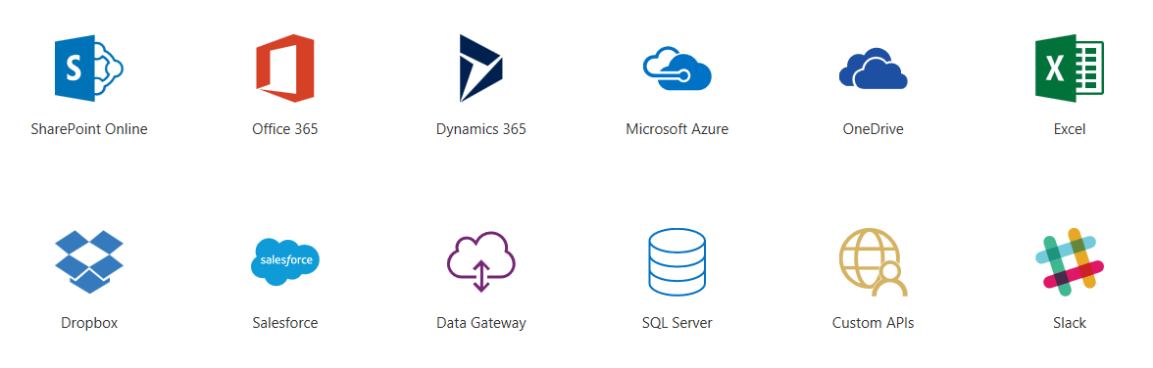
PowerApps
Work in a visual designer to customize fully functional apps without having to write code

Slide 36
Plug-Ins

Slide 37
What is a Plug–in?
A compiled assembly (.DLL) that is installed into the Dynamics CRM event pipeline
Configured by the developer to execute on specific conditions, on specific entities

Slide 38
Why Plug–ins
Written using the same tools and programming languages as Dynamics CRM itself.
Once registered, Dynamics CRM has no idea that it is executing your code vs. its code

Slide 39
Plugin-Ins
Always my last choice
Used when all other methods have been exhausted
Remember that any piece of code is a maintenance point

Slide 40
Developer Tools

Slide 41
Developer Tools
XrmToolbox
http://www.xrmtoolbox.com
XrmToolkit
https://xrmtoolkit.com
Developer Toolkit
https://marketplace.visualstudio.com/items?itemName=DynamicsCRMPG.MicrosoftDynamicsCRMDeveloperToolkit

Slide 42
Next Steps

Slide 43
Next Steps
Download and review the Dynamics 365/CRM SDK
https://www.microsoft.com/download/details.aspx?id=50032
Sign up for KnowledgeBits
http://www.xrmcoaches.com/knowledgebits
Download free Training Guides and Learning Plans
http://www.xrmcoaches.com/freestuff
Watch previous webinars
http://www.youtube.com/xrmcoaches

Slide 44
Questions?

Slide 45
Thank You

